Slide 1
Graph Traversal
Suyash Shekhar

Slide 2
How to get out of the Maze Runner maze?

Slide 3
bfs/dfs

Slide 4
Different from Binary Tree Traversal

Slide 5
for all v in V visited[v] ← 0 p[v] ← -1 Q ← {s} visited[s] ← 1 while Q is not empty u ← Q.dequeue() for all v adjacent to u if visited[v] = 0 visited[v] ← true p[v] ← u Q.enqueue(v)
BFS

Slide 6
DFSrec(u) visited[u] ← 1 for all v adjacent to u if visited[v] = 0 p[v] ← u DFSrec(v) for all v in V visited[v] ← 0 p[v] ← -1 DFSrec(s)
DFS

Slide 7
Path Reconstruction
void backtrack(u)
if (u == -1)
stop
backtrack(p[u])
Output u
i ← t
while i != s
Output I
i ← p[i]
Output s
Correct Order
Reversed Order

Slide 8
Topological Sort

Slide 9
myList = [] DFSrec(u) visited[u] ← 1 for all v adjacent to u if visited[v] = 0 p[v] ← u DFSrec(v) for all v in V visited[v] ← 0 p[v] ← -1 DFSrec(s) return myList.reverse()
DFS(again?)
// Add a line here to record down the node u.
myList.append(u)

Slide 10
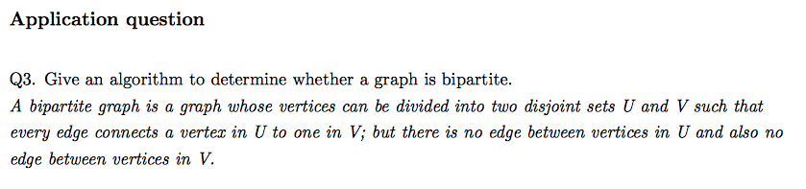

Slide 11
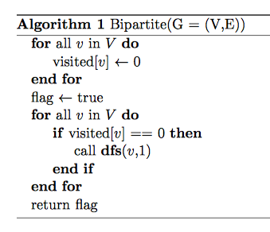
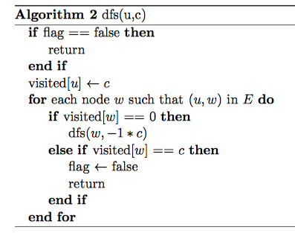

Slide 12
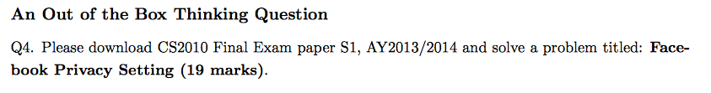

Slide 13
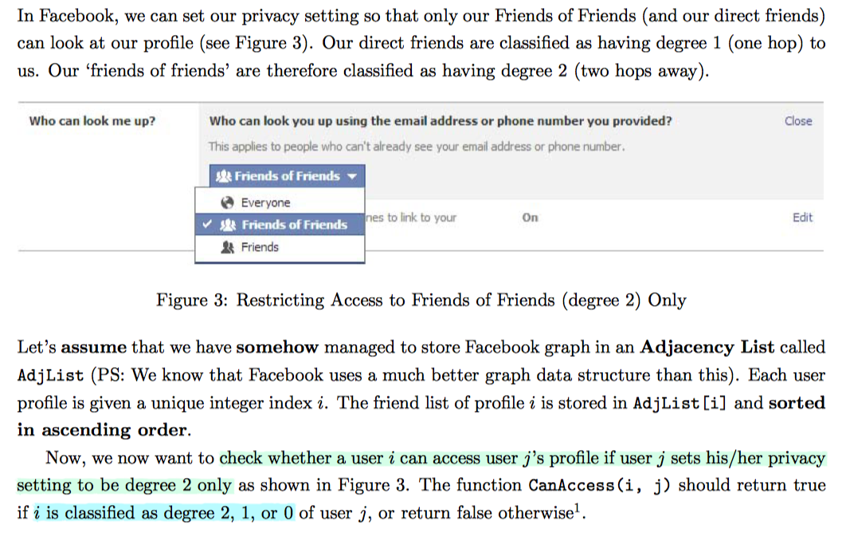

Slide 14
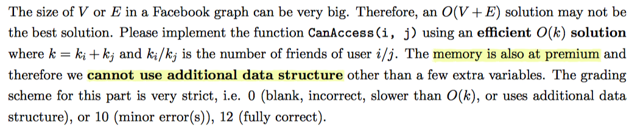

Slide 15
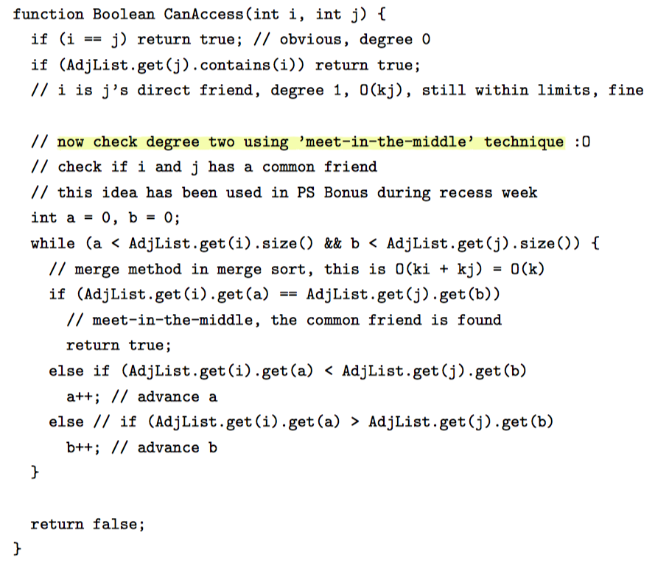

Slide 16
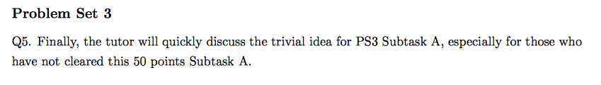

Slide 17
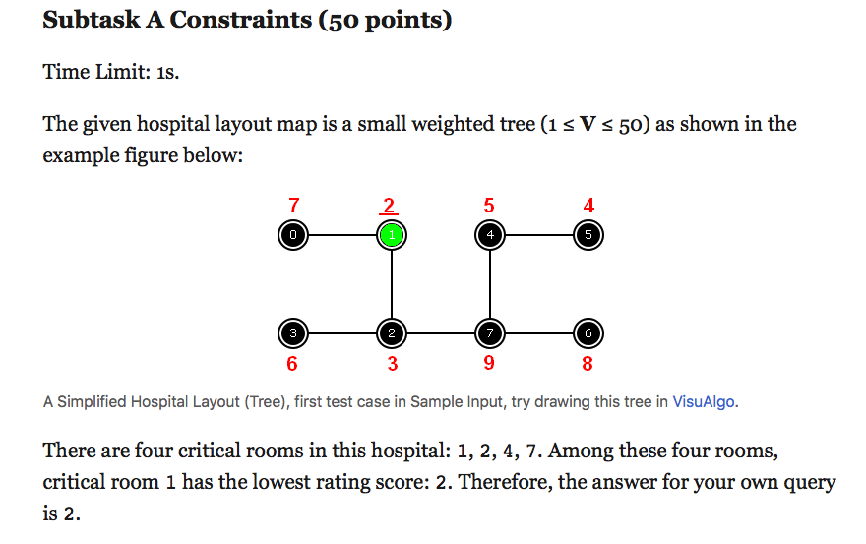

Slide 18
Here we are again, what is a tree?

Slide 19
DISCLAIMER: The following slides contain disturbing corner cases of dfs using a stack which can be confusing at first and then continue to remain confusing for a long time. The following content is not necessary for CS2010 and so if you do not want to get confused any further, please take out your phones and browse instagram until the tutor announces that it is safe to look back at the screen again.

Slide 20
How different are BFS and DFS really?

Slide 21
def bfs(graph, start): visited, queue = set(), [start] while queue: vertex = queue.dequeue() if vertex not in visited: visited.add(vertex) queue.extend(graph[vertex] - visited) return visited
BFS

Slide 22
def dfs(graph, start): visited, stack = set(), [start] while stack: vertex = stack.pop() if vertex not in visited: visited.add(vertex) stack.extend(graph[vertex] - visited) return visited
DFS?

Slide 23
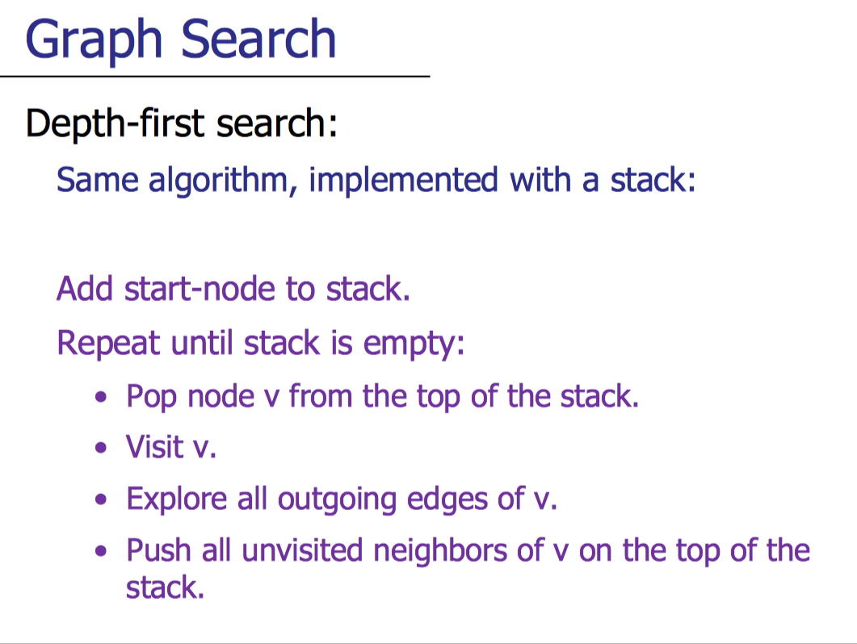

Slide 24
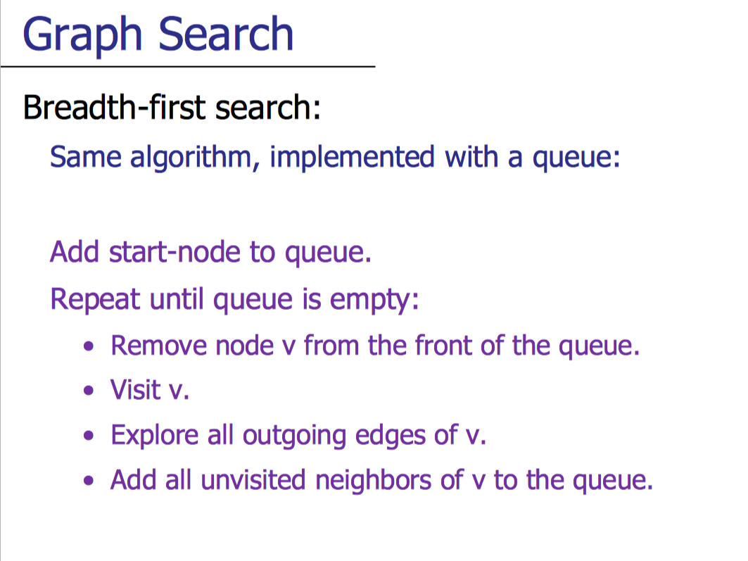

Slide 25
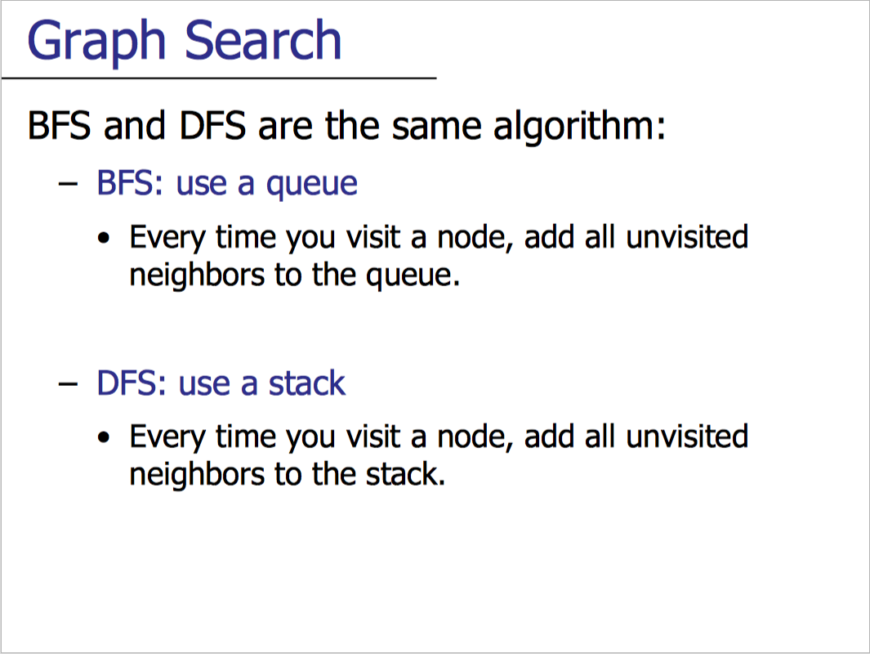

Slide 26
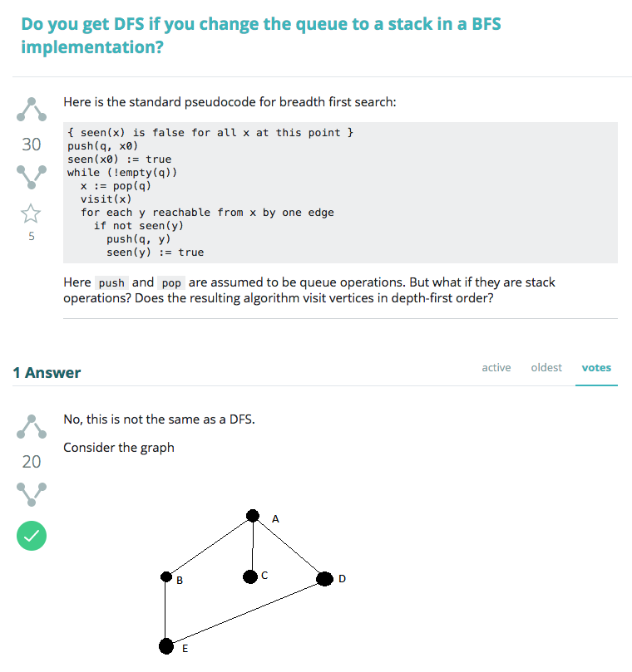

Slide 27
http://www.egr.unlv.edu/~larmore/Courses/CSC477/bfsDfs.pdf

Slide 28
BYE

